Slide 1




T&J Jewelry
Max Chervinsky, Andrew Clark, Jacob Johnson

Slide 2

About T&J
What is T&J?
Where was the org?
What was our goal?

Slide 3
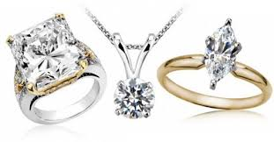
TJ Jewelry
Objectives
Transfer TJ Jewelry from VisualForce pages to a Single Page Application using Aura.
Provide uniform styling for the Single Page Application.
Implement features of Sales and Service cloud.
Technology Used
Aura Component
Aura Event
JavaScript Controller
Apex Controller
Apex Testing
Vision/Business Model
Jewelry company that provides products and services to customers with an intuitive and inviting platform.
Establish open communication channels between clients and associates.

Slide 4
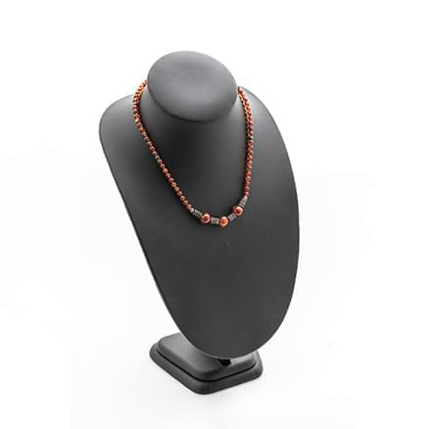

Conversion of Pages
Home page
Cart page
Account form

Slide 5
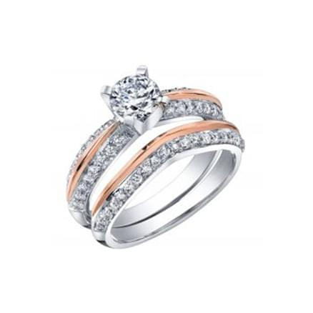
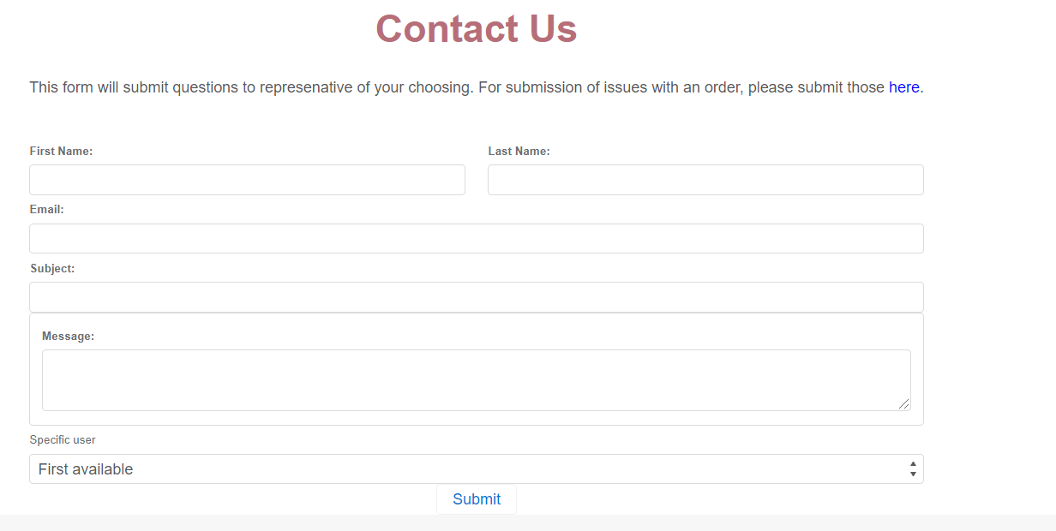
Contact Us
Customer facing
Select individual representative
Automated email
Code coverage

Slide 6
Product Search
Displays a table of store products available
Takes in Name of product, Jewelry Type, and Jewelry Style
Since Jewelry Style Picklist is dependent on Jewelry Type, the input field doesn't render until a Jewelry Type is picked
Filters data returned based on the user's input
Testing percentage: 73%

Slide 7

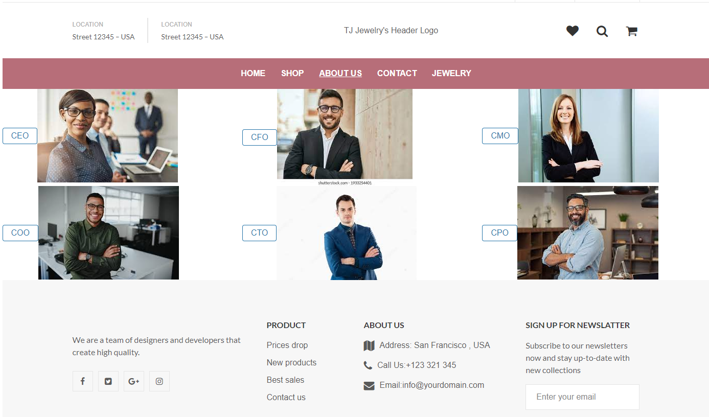
About Us
Customer Facing Information Page
Interactive Page
Appointment Record Creation
Code Coverage

Slide 8
Sales/Service Cloud
Dashboard of product information
Case submission
Separate from Contact Us

Slide 9
Demonstration

Slide 10
Future Work
Dynamic VIPs
Contact form attachments
More aura components
Product Manipulation

Slide 11
Questions?

